Slide 1
Euler path/circuit algorithms

Slide 2
Euler path/circuit algorithms
Fleury’s Algorithm
Hierholzer Algorithm

Slide 3
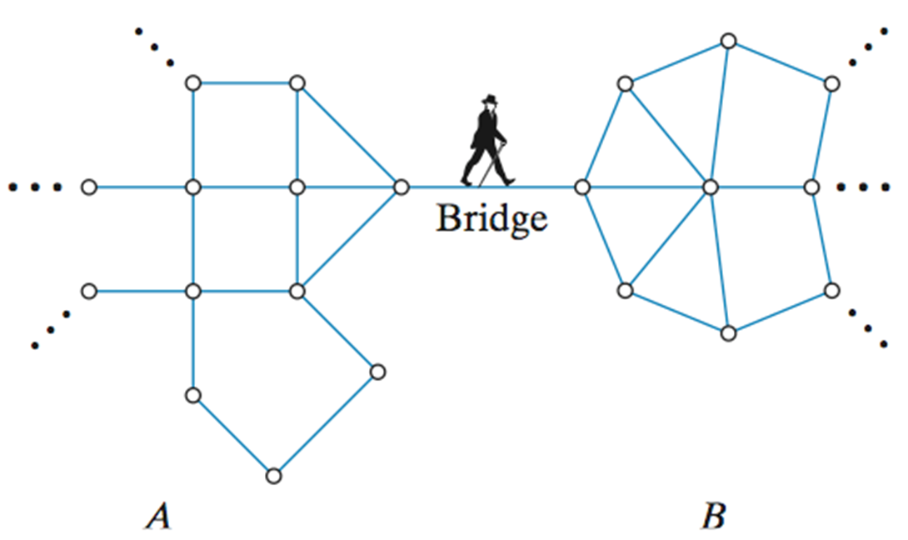
Fleury’s Algorithm
The idea behind Fleury’s algorithm: “Don’t burn your bridges behind you”
A bridge (cut-edge or cut arc) is an edge of a graph whose deletion increases the graph's number of connected components. Equivalently, an edge is a bridge if and only if it is not contained in any circuit.

Slide 4
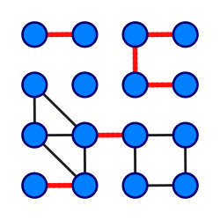
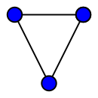
Fleury’s Algorithm
six bridges
no bridge edges

Slide 5
Fleury’s Algorithm
Make sure the graph has either 0 or 2 odd vertices.
If there are 0 odd vertices, start anywhere. If there are 2 odd vertices, start at one of them.
Follow edges one at a time. If you have a choice between a bridge and a non-bridge, always choose the non-bridge.
Stop when you run out of edge

Slide 6
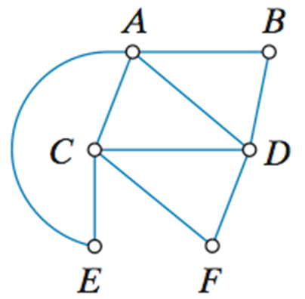
Fleury’s Algorithm

Slide 7
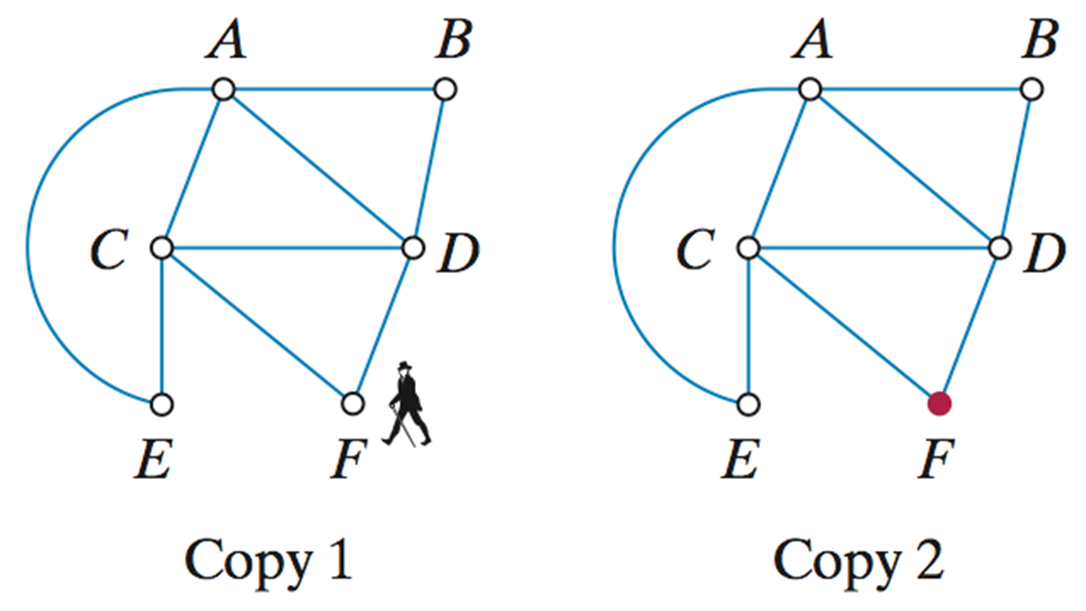

Slide 8
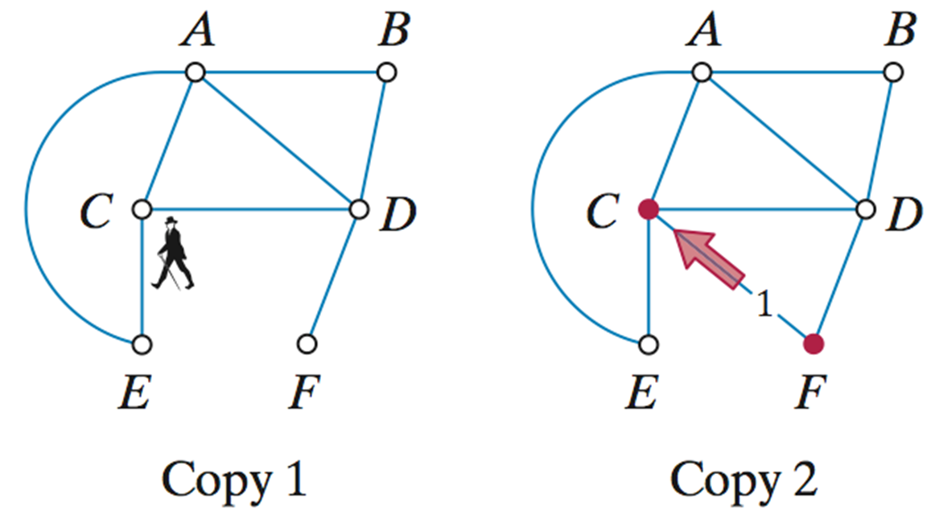

Slide 9
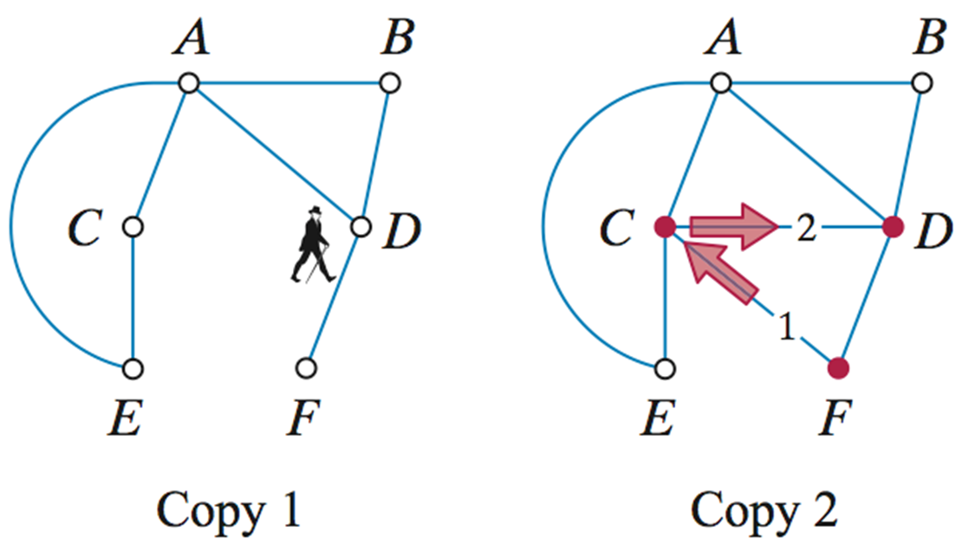

Slide 10
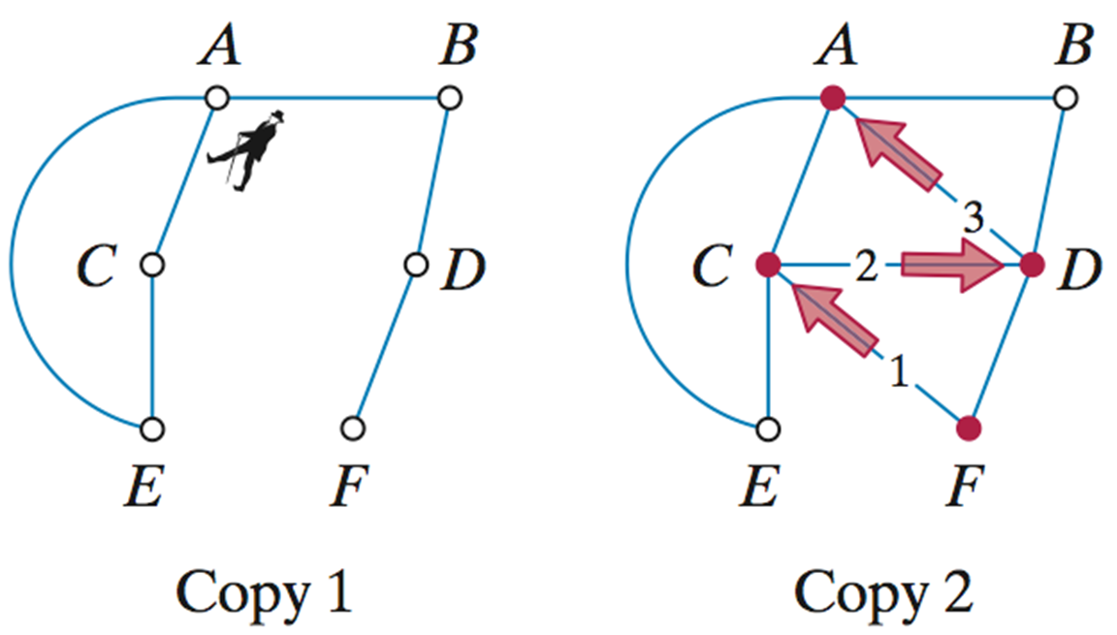

Slide 11
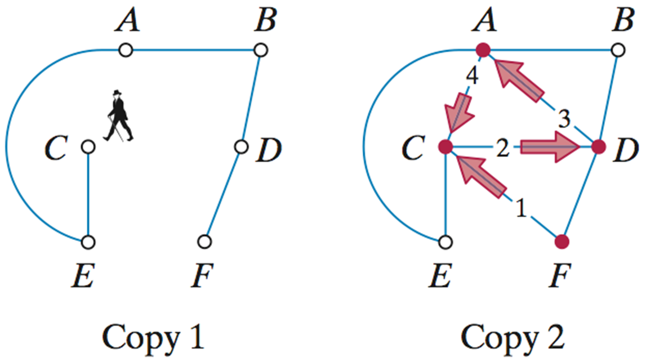

Slide 12
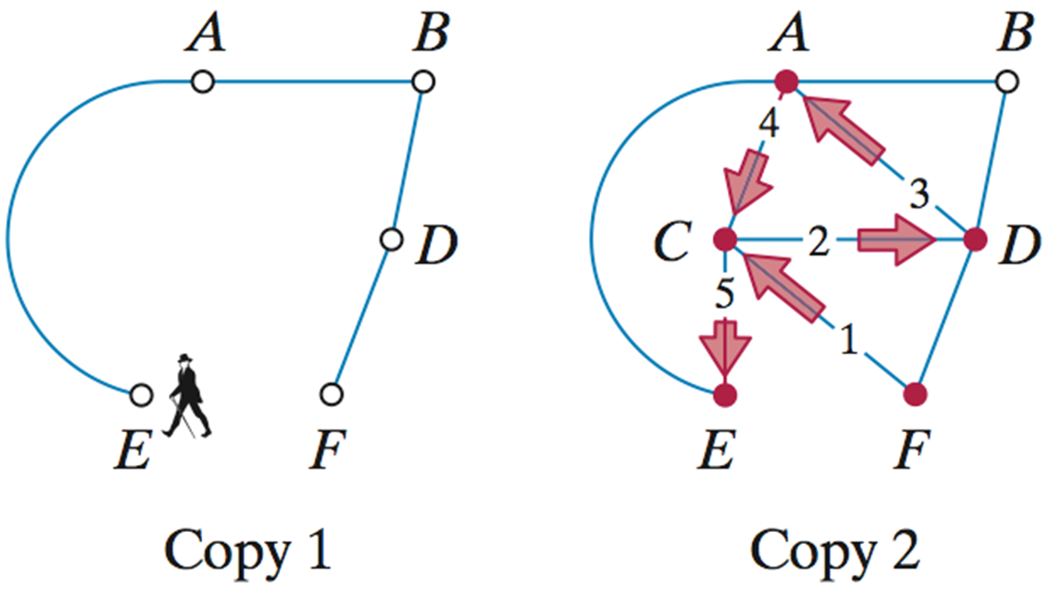

Slide 13
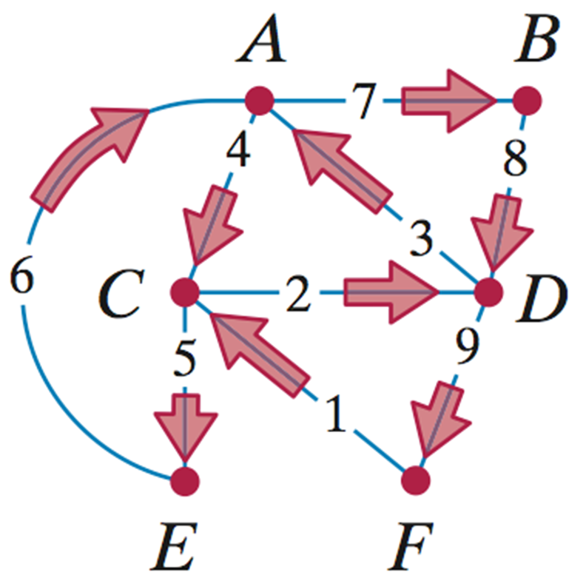

Slide 14
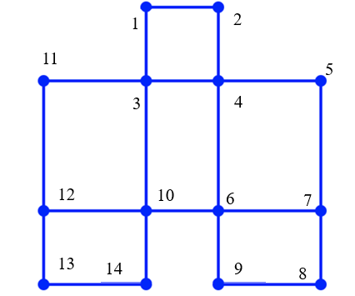
Fleury’s Algorithm

Slide 15
Fleury’s Algorithm
Fleury’s Algorithm is inefficient algorithm to find Euler Path/circuit.
Required to check if a edge is bridge
How???
Time complexity O(E(V+E))
Space complexity O(V+E)

Slide 16
Hierholzer Algorithm
Initialization:
If looking for an Eulerian circuit, start from any vertex. If looking for an Eulerian path, start from a vertex with an odd degree.
Construct Initial Path:
Start at the chosen vertex and follow edges one at a time, removing them from the graph, until you return to the starting vertex (for a circuit) or reach the end of the path (for a path).

Slide 17
Hierholzer Algorithm
Handle Remaining Edges:
If there are unused edges remaining, find a vertex in the current path that still has adjacent unused edges. Start a new path from this vertex, following unused edges until returning to the start of the new path.
Splice this new path into the existing path.
Repeat:
Repeat the process of finding new paths and splicing them into the existing path until all edges have been used.

Slide 18
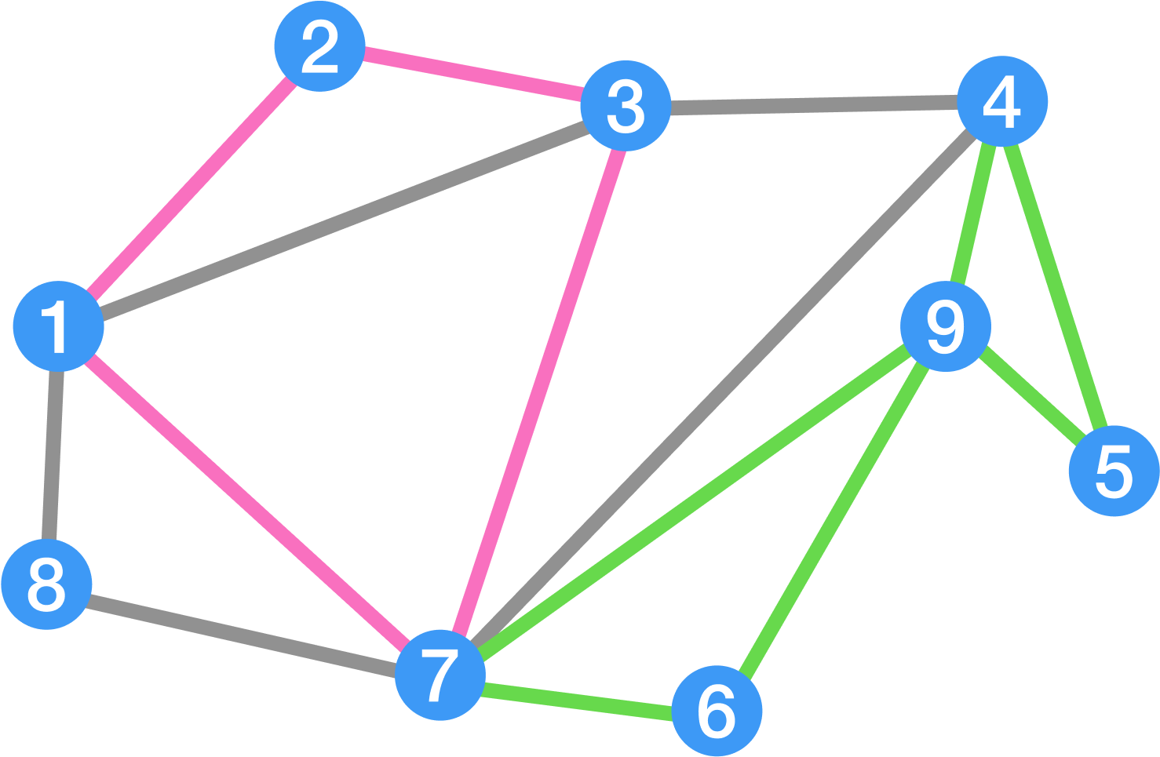
Hierholzer Algorithm

Slide 19
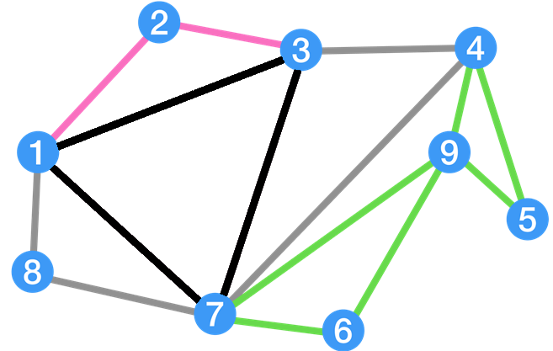
Hierholzer Algorithm
Initialization: All vertices has even degree, so we can start at any vertex.
Construct Initial Path: 1-> 3 -> 7 -> 1

Slide 20
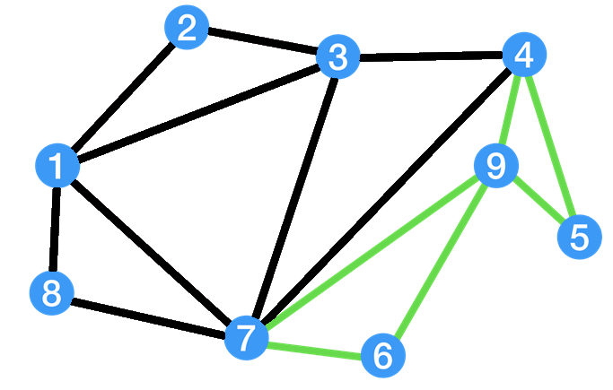
Hierholzer Algorithm
Handle Remaining Edges:Vertex 1: 1-> 2-> 3-> 4-> 7 -> 8 -> 1
=> The “update circuit”: 1-> 2-> 3-> 4-> 7 -> 8 -> 1-> 3-> 7 -> 1

Slide 21
Hierholzer Algorithm
Handle Remaining Edges:
Vertex 7: 7-> 9->4 -> 5 -> 9 -> 6 -> 7
=> The “update circuit”: 1-> 2-> 3-> 4-> 7 -> 8 -> 1 -> 3 -> 7 -> 9 -> 4 -> 5 -> 9 -> 6 -> 7-> 1

Slide 22
Hierholzer Algorithm

Slide 23
Hierholzer Algorithm
Time complexity O(E)
Space complexity of O(V+E)

